Slide 1
Hydropower in Nepal
Dr. Rajesh Kazi Shrestha
President
Nepal-China Chamber of Commerce & Industry
International Chamber of Commerce Nepal

Slide 2
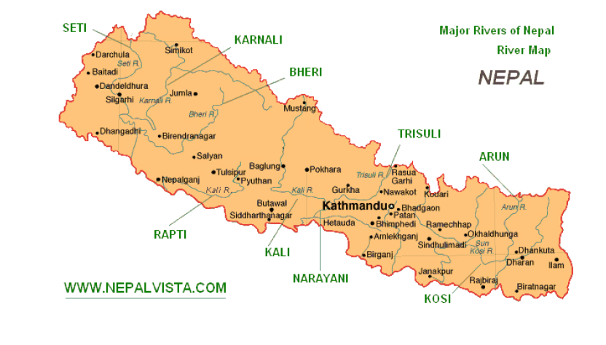
Hydropower profile of Nepal
Nepal is known to be top nation of the world in terms of water resources but the reality is we are still living in dark and we are currently passing through the severe energy crisis. Each year, load shedding is increasing.
Major Rivers

Slide 3
Hydropower Profile
There are about six thousand big and small rivers in three major river basins namely Koshi, Gandaki and Karnali
More than 6000 rivers originated from Nepal flows to India.
Hydropower projects are under construction from 3000 M High elevation to as low 500 m
Farping Hydropower Plant commissioned in 1911, 100 yrs of History
Estimated water storage potential = 88 billion m3
Estimated theoretically potential hydropower = 85,000MW
43 000 Estimated Technically viable Hydropower = 43,000 MW
Present Status of Energy
- Hydro : Government of Nepal (GON) 478MW–Installed capacity–645 MW
- Thermal: Installed Capacity – 53MW (GoN)
- Solar: 200 Kw (2 x 100)
Electricity Access to people – 42% of Population

Slide 4
Institutional Arrangements
A number of institutions exist in the energy sector.
a) Ministry of Energy,
b) Ministry of Forests and Soil conservation,
c) Ministry of Agriculture and Co-operatives
d) Ministry of Commerce and Supplies,
e) Ministry of Environment and Ministry of Industry
f) Nepal Investment Board
Commissions:
a) National Planning Commission
b) Water and Energy Commission
c) Corporation and Others
d) Nepal Electricity Authority

Slide 5
Policy Documents
The following have been major policy documents guiding energy production, development, utilization and regulation
Development Plan
Until 1990, hydropower development was under the domain of government utility
From 1992, hydropower development was opened for private sector
New policy seek investment by private sector and expand electrification within the country and export
Hydropower Development Policies 1992 and 2001, Water Resources Act 1992, and Electricity Act 1992
Water Resources Strategy 2002 and National Water Plan 2005
National Electricity Crisis Resolution Action Plan 2008
Rural Energy Policy 2006
Foreign Investment and Technology Transfer Act - 1992
Environment Protection Act - 1996 (Regulation-1997)
Nepal Government’s policy and plan of 10,000 MW in 10 years (2010-2020) and 25,000 MW in 20 years (2010-2030)

Slide 6
Opportunities
High potential for Ponding type of Projects:
  Upper Karnali West Seti Burhi Gandaki Pancheswar
Interested foreign investors
  More and more Chinese and Indian investors are interested to invest in Hydropower projects
High flow in rivers
- Himalaya is the source of most rivers of Nepal.
High demand in local market
High potential demand in Regional Market
  Highly populated areas of India and Bangladesh are located near to Nepal. Electricity market is available. Surplus energy can be exported.
Clear financial incentives
  Exemption of corporate tax for 7 years and 50 % for next 3 years
  Exemption of VAT on machines, equipments
Private/foreign investor favorable policy of Government
Environmental risk free after construction

Slide 7
Installed Capacity
Description Capacity (MW)
Total Grid Connected Hydro Power 698
Diesel Plants (Thermal)- Capacity 53
Peaking Capacity 668
Import from India 150
Peak Demand 885
Deficit - Wet Season -217 (885-668)
Deficit - Dry season (January-June) -685 (885-200)
* Nepal Electricity Authority Report, 2010
698 MW is installed capacity, in dry season only about 200 MW
electricity produced, more than 14 hrs Load shedding in dry season

Slide 8
Conclusion
Hydropower is the prominent sector for investment in Nepal
It is the only sector which take place in least developed and remote areas.
It leads to development of road and creates many economic opportunities to local people.
Recent years we can see lot of foreign investors who are willing to invest in Nepal.
Government should focus on common minimum agenda for hydropower development with favorable policies.

Slide 9
Thank You

